Slide 1
The SAS Supervisor
By Don Henderson
PhilaSUG, June 18, 2018
The SAS Supervisor paper, was originally presented
in the Tutorials Section of SUGI 83.
It has been presented/repeated countably infinite other
times and places including at SUGI 87, 88, 90, 91, 92
Online at https://communities.sas.com/t5/SAS-Communities-Library/The-SAS-Supervisor/ta-p/429216

Slide 2
Abstract
How SAS processes jobs is the responsibility of the SAS Supervisor and an understanding of it's function is important.
While the details of how it works have changed over time, some of the basics of the SAS Supervisor have been reasonably consistent over time.
DISCLAIMER
This talk dates back to about 35 years ago.
Some things presented here may have changed that I did not catch/note in this updated presentation.
☺

Slide 3
Functions of the SAS Supervisor
Two primary functions:
Compiling SAS Source Code, and
Executing Resultant Machine Code
When a SAS DATA Step program is written, the DATA Step module must be integrated within the structure of the SAS System. This integration is done by the SAS Supervisor. Gaining a more complete understanding of what the Supervisor does and how our program is controlled by it is crucial to using the SAS System more effectively.

Slide 4
Structure of SAS Jobs – 1 of 2
Distinct compile and execute steps for all SAS jobs.
The SAS Supervisor, handles the compile and execution steps of a SAS job.
Distinct compile step and execution steps for each DATA or PROC step in a SAS job.
  Compiled & executed independently according to their sequence in the program.
  The first DATA/PROC step is compiled and then executed; this is then followed by the compilation and the execution for the next DATA/PROC step, etc.
  The SAS Supervisor controls this processing.

Slide 5
Structure of SAS Jobs – 2 of 2
The SAS programmer has tools that allows him/her take full advantage of the compile/ execute structure for SAS jobs. For example:
  The Macro Language, can be used to control the sequence of DATA/PROC steps seen by the Supervisor and of the statements contained within each step.
  Techniques and tools are available within a given DATA Step as well. For example:
    Conditional execution of a read operation
    Reading data within a loop - now known as the DOW loop and Paul Dorfman will expand upon the DOW loop in his presentation.

Slide 6
Compile Time Processing
At compile time, the SAS Supervisor creates both permanent and transient entities.
The primary permanent entity is the directory or header portion of the SAS data set. The data is added to the data set at execution time.
The primary transient entities are a variety of buffers, flags and work areas which, at execution time, control the creation of the desired output.

Slide 7
Compile Time Processing
Partial list of the SAS Supervisor compile time activities:
Syntax scan and defining of input and output files including variable names, their locations and attributes.
Creation of the Program Data Vector (AKA the PDV).
Specification of variables to be written to the output SAS data set.
Specification of variables which are to be initialized to missing by the SAS Supervisor between executions of the DATA Step and during read operations.
Creation of a variety of flag variables which are used by the Supervisor at execution time.

Slide 8
Creation of the Program Data Vector
The Program Data Vector (PDV) is a logical construct.
It is a buffer which includes all variables referenced either explicitly or implicitly in the DATA Step.
At execution time it is the location where the working values of variables are stored as they are processed by the DATA Step program.
Created at compile time by the SAS Supervisor.
Variables are added to the PDV sequentially as they are encountered during the parsing and interpretation of SAS source statements.

Slide 9
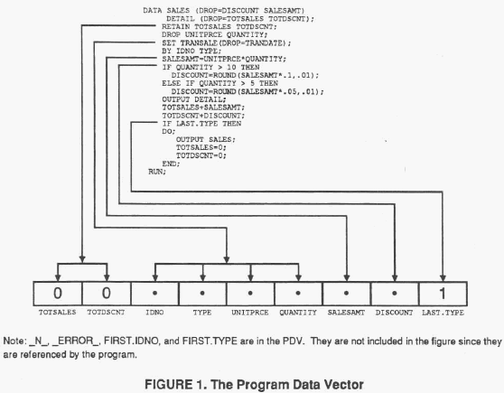
Creation of the Program Data Vector
Variables are added to the PDV by the first occurrence or reference in the SAS source statements.

Slide 10
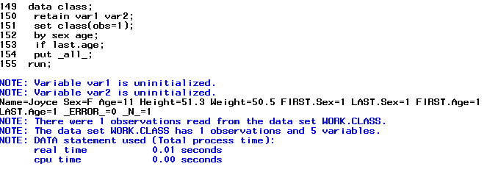
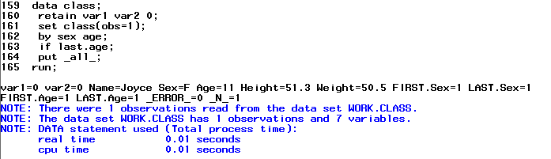
Some Differences from Jurassic Times
Need to assign a value.

Slide 11
Specification of Variables for Output
The Drop/Keep Table (the DKT) - A logical construct.
The PDV variables to include in the output SAS data set.
The DKT has a one-to- one relationship to the PDV – a column for each variable in the PDV.
A row for each output data set.
DKT can only take the values of D or K - for Drop and Keep.
Values assigned at compile time and can not be altered during the execution phase of a DATA Step.

Slide 12
The DKT Table – Order of Operation
Input data set options first.
DROP Statements
KEEP Statements
Output data set options last.

Slide 13
DKT Rules – 1 of 3
For each variable in the PDV:
  set all of its DKT values to D if it is a SAS special variable (e.g., _N_, _ERROR_, END=, IN=, POINT=, FIRST, and LAST, variables, and implicit ARRAY indices).
  Otherwise set the DKT values to K.
DROP statement changes to DKT are made before KEEP statement changes.
For each variable in a DROP statement with its DKT value equal to K, change it to D. If the DROPped variable is not found, set an error condition. The error message is:
The variable <name> in the DROP, KEEP, or RENAME list has never been referenced.
Most often occurs when:
A variable is listed in more than one DROP statement
Or listed more than once in a single DROP statement
Or a variable not in the PDV is listed in a DROP statement
Or a SAS automatic variable is listed in a DROP statement.

Slide 14
DKT Rules – 2 of 3
If any KEEP statements are present:
  Create a list of unique variable names from all KEEP statements.
  This list is compared with variables in the PDV that have their DKT value equal to K.
  The Supervisor makes no changes to the DKT values for matching names. Mismatches are:
    Variables in the PDV with DKT equal to K but not in the list of unique variables from all KEEP statements, set the DKT value to D
    Variables in the list compiled from all KEEP statements which do not match variables in the PDV with DKT equal to K, display this error:
    The variable <name> in the DROP, KEEP, or RENAME has never been referenced.
Most often occurs when:
A variable is listed in a DROP statement and a KEEP statement
Or a variable not in the PDV is listed in a KEEP statement
Or a SAS automatic variable is listed in a KEEP statement.

Slide 15
DKT Rules – 3 of 3
Process DROP and KEEP output data set options, using the same rules and precedence (DROP before KEEP)

Slide 16
Initialization to Missing Values
Initializing variables to missing between executions of the DATA Step is also illustrated by a buffer with a one-to- one correspondence to the PDV. The elements of this Initialize to Missing Vector (ITMV) can take three possible values:
  Y - Initialize to missing between each execution.
  N - Do not initialize to missing.
  R - The read operation (i.e., SET, MERGE or UPDATE) will perform the initialization to missing values.
These values, are defined at compile time and can not be changed at execution time.
Only used when multiple data sets are being read

Slide 17
ITMV Rules – 1 of 2
Initially set to Y and change to N for:
All SAS special variables .
All variables listed in a RETAIN statement.
All accumulator variables used in a sum statement:
  Variable + (expression);
  Change from earlier releases – applies even to ARRAY references.

Slide 18
ITMV Rules – 2 of 2
Variables referenced in SET, MERGE or UPDATE statements have ITMV values set to N or R using the following rules:
Set to N for variables read from a single SAS data set with the SET statement.
Where two or more data sets are read with a SET, MERGE or UPDATE statement, ITMV values for the variables from those data sets are set to R.

Slide 19
Process Control Flags
Values for both the DSFF and EDSF are set at execution time
In addition to the previously discussed constructs, other flag variables are created at compile time and are used at execution time.
The Data Step Failed Flag (DSFF).
The End Data Step Flag (EDSF).
The Output Statement Present Flag (OSPF) is set to Y if there is any output statement present in the DATA Step program, otherwise it is set to N.

Slide 20
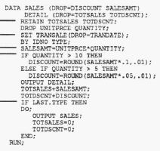
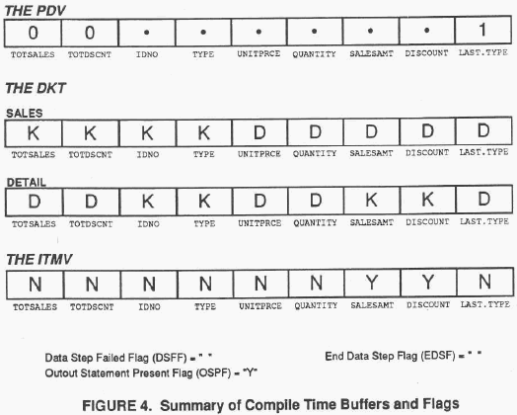
Compile Time Constructs

Slide 21
Non-Executable/Information Statements
ARRAY
ATTRIB
BY
DROP
FORMAT/INFORMAT
KEEP
LABEL
LENGTH
RENAME
RETAIN
. . . . . And more?
Because these statements have their primary effect at compile time, their location within the DATA Step code may not be important – except for those statements that define the type or length of the variable.

Slide 22
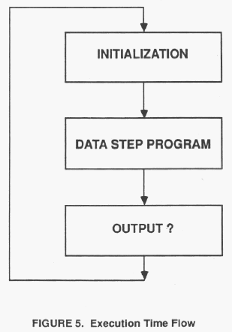
Execution Time
Initialization of variables in the PDV to missing.
Execution (calling) of the DATA Step program.
0utputting or copying values of variables in the PDV to the output SAS data set.
Repeating steps 1-3 until the input data source is exhausted.

Slide 23
Execution Time Program Flow
Initialize the contents of the PDV before every execution of our DATA Step program: For each variable in the PDV with its corresponding ITMV = Y, set it to missing.
The DATA Step program is then executed and the programming statements that comprise the DATA Step are executed, supplying values for the variables in the PDV.
Once the DATA Step program has finished, control is returned to the SAS Supervisor which decides whether to copy the contents of the PDV to the output SAS data set:
  If OSPF = N and DSFF =N,
  For each variable in the PDV with its corresponding DKT=K, copy its current value from the PDV to the output SAS data set.
Same logic the SAS Supervisor uses when the user’s program executes the OUTPUT statement.

Slide 24
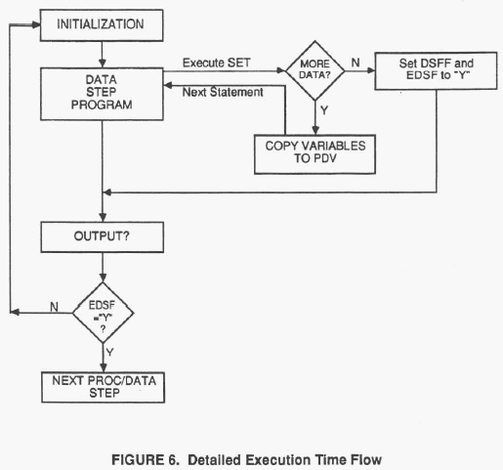
Expanded Flow Diagram
INITIALIZATION: set the values of DSFF and EDSF to N.
Execute the DATA Step program, statement by statement.
  When executing the read operation the SAS Supervisor checks if there is more input data.
    If no more data:
      Set DSFF and EDSF to Y
      Immediately return control to the SAS Supervisor.
    Otherwise, copy the variables from the input data set to the PDV, set the values of any appropriate special
  Continue with the DATA Step executable statement in the DATA Step.
Upon return of control to the Supervisor:
  If OSPF=N and DSFF=N then execute the OUTPUT logic.
  If EDSF=Y then end the DATA Step and proceed to the next DATA or PROC step. Otherwise, repeat the above steps.

Slide 25
The DSFF and EDSF Flags
The following statements all cause an immediate return to the SAS Supervisor with the indicated values for the flags
Statement | DSFF | EDSF
ABORT | Y | Y
DELETE | Y | N
IF false <expression> | Y | N
RETURN | N | N
STOP | Y | Y
Failed read Operation (INPUT, SET, MERGE, UPDATE) | Y | Y
A nuance:
When OSPF=Y, DELETE, a false subsetting IF <expression> and RETURN are equivalent.
The default OUTPUT is dependent on both OSPF=N and DSFF=N, i.e., the value of DSFF has no impact.

Slide 26
Set/Merge Operations Overview
The SAS read operations SET and MERGE perform two general actions when executed:
  Call a SAS Supervisor routine to initialize selected variables in the PDV to missing.
  Copy variable values from one or more SAS data sets to the PDV.
Let’s review these rules for selected examples.

Slide 27
SET – More than 1 Data Set, No BY
When a SET statement references more than one SAS data set, and no BY statement is present, the data sets listed on the SET statement are concatenated.
Determine which data set is being read and set IN= and END= variable values.
If the SET statement will read from a different data set compared to its last execution, then initialize all variables in the PDV with ITMV values of "R" to missing.
Copy the values of variables from the current data set to the PDV.

Slide 28
SET – More than 1 Data Set, With BY
Note when the IN, END, FIRST. and LAST. variables are set.
Not on every execution!
When a SET statement referencing more than one SAS data set has a BY statement associated with it, the data sets listed on the SET statement are interleaved.
Determine which data set is being read by looking ahead to the values of the variables in the BY statement for the next observation in each data set. Set values for IN= and END= variables.
If the observation to be read is the first observation for a new BY group:
  Set the appropriate FIRST, variables to 1.
  Set all variables in the PDV with ITMV values of R to missing.
If the SET statement will read from a different data set compared to its last execution, regardless of whether the BY group changes, then initialize all variables in the PDV with ITMV values of R to missing.
Copy variable values to the PDV from the current data set.
Look ahead to the values of the variables in the BY statement for the next observation in each data set. If there are no more observations for this BY group then set the appropriate LAST, variables to 1.

Slide 29
MERGE – No BY
When a MERGE statement with no BY statement is present, the observations in the data sets listed on the MERGE statement are merged one-to-one.
Copy variables values to the PDV from next observation in the first data set listed on the MERGE statement, then the second data set, and so on until all data sets have been read.
If end-of-file has been reached for a data set and no observation is read, initialize variables unique to that data set to missing.
Set IN= variables depending on which data sets are read.

Slide 30
MERGE – With a BY
When a MERGE statement with a BY statement is executed, the observations in the data sets listed are merged according to the values of the variables on the BY statement.
Determine which data sets are being read by looking ahead to the values of the variables in the BY statement for the next observation in each data set.
If the observation(s) to be read represent a new BY group:
  Set the appropriate FIRST, variables to 1.
  Set all of the IN= variables to 0.
  Set all variables with ITMV values of R to missing.
For each data set listed on the MERGE statement having another observation for this BY group:
  Set the appropriate IN= variable to 1.
  Copy variable values from the data set to the PDV.
Look ahead to the next observation in each data set to determine if any more observations are present for this BY group. If not, set the appropriate LAST, variable values to 1.

Slide 31
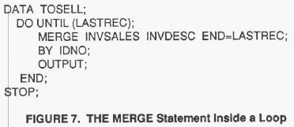
Example 1 – The DOW Loop
First documented example?
Works because of the ITMV rules.

Slide 32
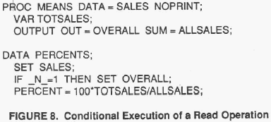
Conditional Read Operation
Any SAS read operation can be executed conditionally.
For example, a SAS data set with a single observation that contains a needed constant.
The SAS data set can be read by executing the SET statement only once.
Since variables read from a SET statement referencing a single SAS data set have ITMV values set to N, the constant will not be initialized to missing on subsequent executions of the DATA Step.

Slide 33
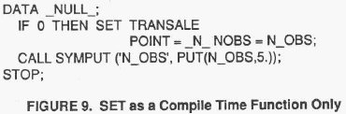
Compile Time Only
Define variables to the PDV based on an existing data set:
Conditionally reference a data set based on a condition that will never be true.
  IF 0 THEN SET INVDESC;
  or
  IF _N_ = -17 THEN SET INVDESC;
  Adds the variables in INVDESC to the PDV. But no data will ever be read.
  Sample uses
    Creating a shell data set.
    Creating a data set that can be PROC APPENDed with no warnings.
Getting the number of observations using the POINT option.
  The value for the NOBS=
  variable (N_OBS) is supplied
  at compile time.
  The only executable
  statements in the DATA Step
  are CALL SYMPUT and STOP.

Slide 34
The SAS Supervisor
By Don Henderson
PhilaSUG, June 18, 2018
The SAS Supervisor paper, was originally presented
in the Tutorials Section of SUGI 83.
It has been presented/repeated countably infinite other
times and places including at SUGI 87, 88, 90, 91, 92
Online at https://communities.sas.com/t5/SAS-Communities-Library/The-SAS-Supervisor/ta-p/429216

